Slide 1
Homer City Holdings LLC Board of Directors Meeting
August 14, 2019
Confidential

Slide 2
Board of Directors Meeting Agenda
7:30am to 1:00pm – Board of Directors Meeting
Dial-in Number: +1 (301) 563-9150 ID: 99525007#
Call to Order/Roll Call
Appoint meeting Secretary
Approval of prior Meeting Minutes
Asset Manager Presentation
Next Meeting
1:00pm to 1:30pm – Executive Session

Slide 3
Homer City Board Meeting Attendees
William A. Wexler – Chairman & CEO
Board of Directors
Steven Gilliland
Kevin Howell
Richard Williams
Andrew Shannahan
CPV
Dave Magill – Senior Vice President, Asset Management
John Smeltzer, Vice President, Asset Management
Nick Rahn – Vice President, Asset Management
Jim Kettering – Vice President, Finance
Tom Minderman – Vice President, Energy Management
Tony Haramis– Vice President, Accounting – via phone
Diana Walker - Director, Energy Management
John Buckman – Director, Finance
NRG
Daryl Miller, Plant Manager

Slide 4
Asset Manager Presentation
Confidential

Slide 5
Asset Manager Presentation Agenda
Current Highlights & Issues
Q2 2019 Operating Results and Operational Overview
2019 / 2020 Forecast & Liquidity Outlook
Winter Hedging
Upcoming Activities
2021 Coal Contract Negotiations
CBA Renewal
Insurance Renewal
2020 Budget Schedule
Next Meeting
Appendix

Slide 6
Q2 2019 Operating Results and Operational Overview
Confidential

Slide 7
Q2 2019 Summary
Despite a mild winter Q1 2019’s $33 MM EBITDA was in-line with budget due to the hedging program and favorable fixed expenses. Plant operating performance showed marked improvements ending the quarter with the three units having favorable availability:
The Station achieved 66% availability in Q2 (11% favorable to budget) with Unit 1 achieving 92% availability while Unit 2&3 completed a 72-day planned outage and a 21-day planned outage, respectively.
Q2 Equivalent Unplanned Outage Factor was 2.7% (6.6% favorable to budget). Homer City has outperformed EUOF budget by 6+ point for the second consecutive quarter.
Unit 2 planned outage was completed on time and below budget. Major work being completed during the outage were SCR upgrade, flame scanner upgrades, and turbine generator inspection.
The winter hedges put in place in early December 2018 have netted $20.3MM YTD in 2019 ($15.3MM favorable to budget) substantially offsetting the unfavorable Net Energy Margins due to the weak winter market.
Capacity factor was 24% under budget due to the mild weather leading to coal inventory remaining steady for the quarter – 356k tons vs budget drawing down to 105k tons.
BPRR services are improving with a record 14 trains being loaded in March and a 4 train monthly average improvement on 2018. Extension was executed in March, 2019.
CFADS for Q1 ended $25MM unfavorable to budget. A large part of the variance is due to the ending coal inventory balance ($19MM vs $6MM budget) as the budget assumed draw down of coal leading up to the spring outage. Homer City ended Q1 with $79MM of available cash, $36MM unfavorable to budget. 2019 year-end cash forecasted to be $13MM under budget.
April preliminary gross margin $5MM unfavorable to budget due to low power prices, balance of 2019 forecast to be close to budget levels.
Update Bullets - lead in bullet to note focus on liquidity and point to slide in deck - thoughts

Slide 8
Q2 2019 Results vs. Budget
Homer City’s Q2 2019 EBITDA of ($36.7MM) was $15.8MM unfavorable to budget, driven mainly by unfavorable net energy margin driven by lower market prices
Gross Margin – Q2
Gross Margin of $16.5MM was $14.8MM unfavorable to budget primarily due to: $14.6MM unfavorable Net Energy Margin due to ATC power prices $6.74/MWh unfavorable to budget driven by low gas prices and resulting in realized dark spreads $9.73/MWh unfavorable to budget.
Fixed Expenses – Q2
Overall Fixed Expenses of $53.2MM were $3.8MM unfavorable to budget. Maintenance expenses for Q2 were $5.9MM unfavorable comprised of $3.4MM unfavorable major maintenance (POH) $3.4MM mainly due U3 POH timing (March to April) which offsets Q1’s $3.7MM favorable timing variance. $2.9MM unfavorable $0.3MM favorable routine maintenance mainly due to zero forced outages partially offset by unfavorable major maintenance (Non-POH) $0.4MM due timing. Labor was $0.4MM favorable due to a true up of 2018 arbitration accrual and other fixed costs were favorable by $1.0.MM due to timing
CFADS – Q2
CFADS of $(50.3)MM was $11MM unfavorable due to the $18.5MM unfavorable EBITDA discussed above and $7.2MM favorable Working Capital/Capex due to cash timing related to receipt of March’s generation
Update FE & CFADS Variances
YTD?
See Appendix for detailed comparison of Q2 actual results vs. Q2 Budget (page 31)
(1) Excluding planned outage hours

Slide 9
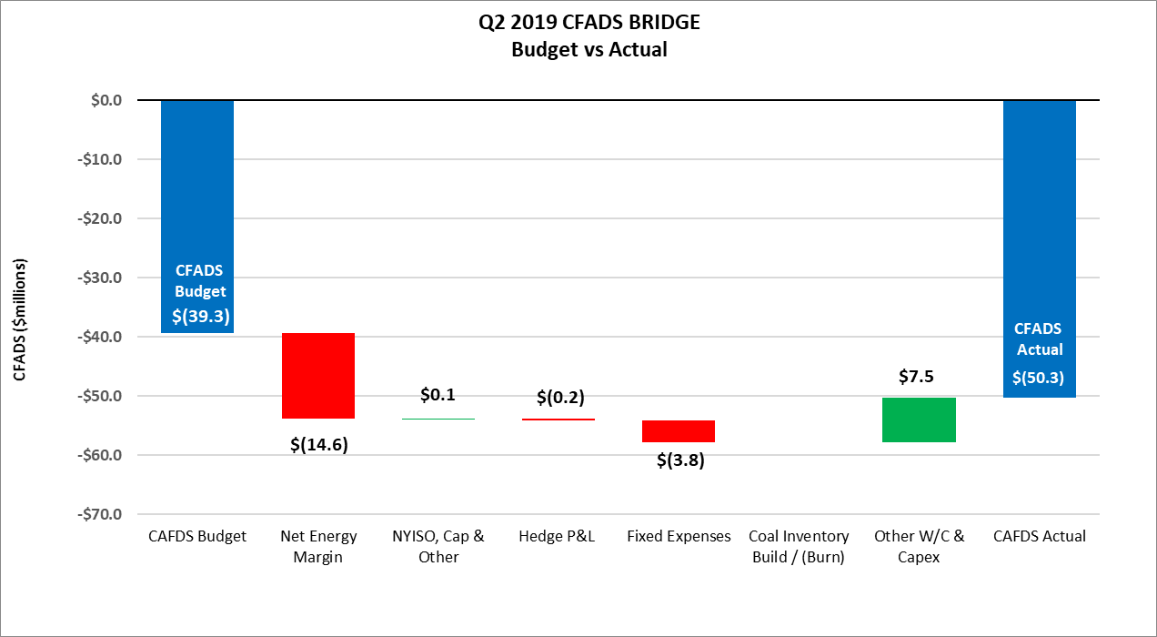
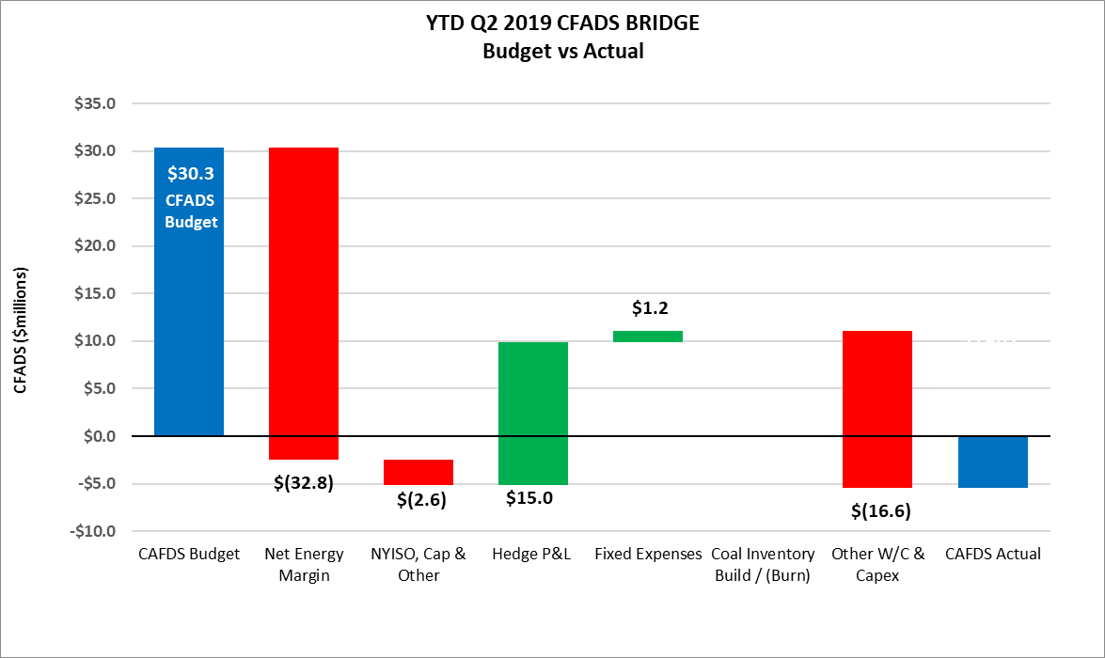
Q2 2019 Actual vs Budget CFADS Bridge
Revise w/ coal timing

Slide 10
Q2 2019 Operational Overview
2019 Actuals: recordables and lost time
happened in Q1. Kettering will update table
Plant achieved 2.7% Equivalent Unplanned Outage Factor
Unit 1 performed the best in Q2 with 92% availability.
Availability was affected by:
54 hours of FO caused by plugged feeders due to wet coal and cracked cooling water hose on “B” phase
Derates due to mills, feeders, bunkers, and NIDS
21-day Catalyst replacement PO
Unit 2 was in a 72-day planned outage throughout Q2 for SCR upgrade and catalyst replacement
The upgrade was successful, and the Unit performed as expected upon return
Unit 3 was in a minor outage for catalyst replacement. Once returned to service, it reached 100% availability in June and 75% for Q2
There were no exceedances or environmental violations
There were no recordable incidents / lost time accidents in Q2
Safety audit performed by third party revealed no major findings. LOTO process was judged to be best in class
Plant continued to perform safety stand-downs to discuss hazards before, during and after major jobs
Start reliability was 100% in Q2 2019 with 7 unit starts
All three units combined for 1,460 hours of reserve shutdown due to low pricing
Notes:
Although Unit 1 & 2 availability was lower compared to unit 3 both Units 1&2 did beat budget by 6 and 11 points respectively
Safety committee meets every third Thursday of every month. Safety committee working on Q2 and Q3 initiative to create 3 focuses programs. The committee came up with two minutes safety drill cards that employees carry all the time

Slide 11
Q2 2019 Site Operations
YTD Availability | Q2-2019
 | Plant | Unit 1 | Unit 2 | Unit 3
Actual Equivalent Availability Factor | 66.1% | 92.0% | 30.0% | 75.4%
Budget Equivalent Availability Factor | 54.6% | 76.9% | 27.1% | 65.3%
Actual Equivalent Unplanned Outage Factor | 2.7% | 8.0% | 0% | 0.1%
Budget Equivalent Unplanned Outage Factor | 9.3% | 12.0% | 4.0% | 12.0%
Q2 Outages and Issues
Unit 1
Unit 1 had 2 forced outages in May (8 Hrs. and 26 Hrs.) and 1 in June (20 Hrs)
Cracked cooling water hose for “B” phase (5/27)
Several coal feeders were plugged due to wet coal (5/31)
Several coal feeders were plugged due to wet coal (6/1)
Mills and feeders accounted for 96% of derated hours on Unit 1
Unit 2
Unit 2 was in planned outage for most of Q2.
Major work completed during the outage includes:
SCR upgrade, SCR catalyst replacement & beam stiffening,
Flame scanner upgrades, high energy piping inspections,
Turbine/Generator inspection.
Unit 3
Unit 3 was in reserve shutdown for 32 days
There was a 21-day planned outage for catalyst replacement
Q2 Derates
Station Derate Hours
Q2 2019 Derate hours by System

Slide 12
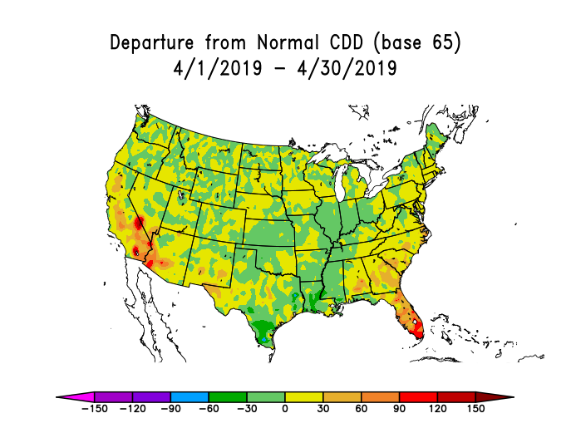
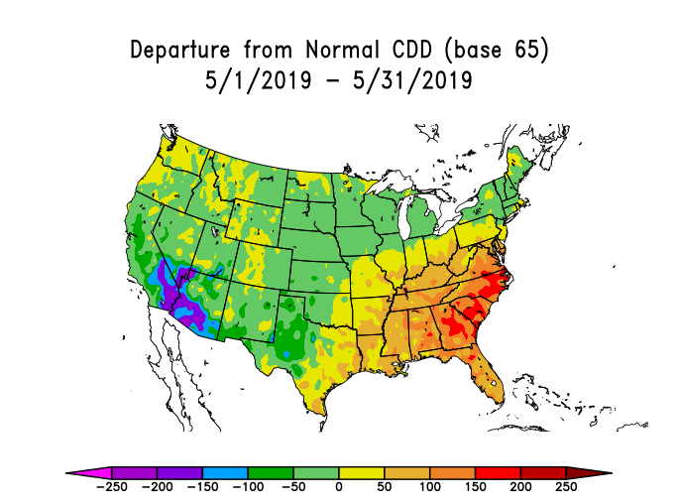
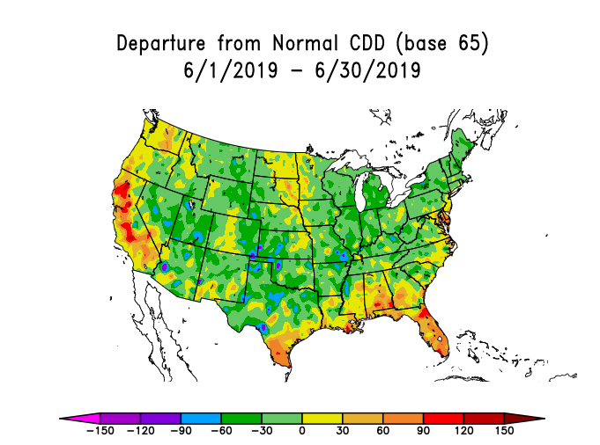
Key Market Information
Note 1: Realized Power Price based on energy revenue excluding hedge gain/loss.
Q2 realized power prices $24.16/MWh unfavorable to budget as a result of unfavorable gas prices
Gas price was unfavorable to budget due to milder than normal weather during the quarter and higher than forecasted storage injection
Coal price $0.15/mmbtu unfavorable to budget due to additional handling costs associated with high SO2 Murray coal during the quarter
Murray coal contract was $6.4MM favorable to spot priced coal purchases in Q2
NYISO price spread unfavorable to budget $1.67/MWh
Coal Q2 2019 – Actual vs. Budget (‘000 tons) | Actual | Budget
Beginning Inventory | 346 | 104
Plus: Receipts | 741 | 873
Less: Burn | 428 | 588
Ending Inventory | 659 | 390
Less: Unusable base inventory | 65 | 65
Less: Coal requiring blending | 40
Net Useable Inventory | 554 | 325
Inventory Days At Avg. Burn | 55 | 38
Ending Inventory Value ($MM) | $34 | $10

Slide 13
2019 / 2020 Forecast & Liquidity Outlook
Confidential

Slide 14
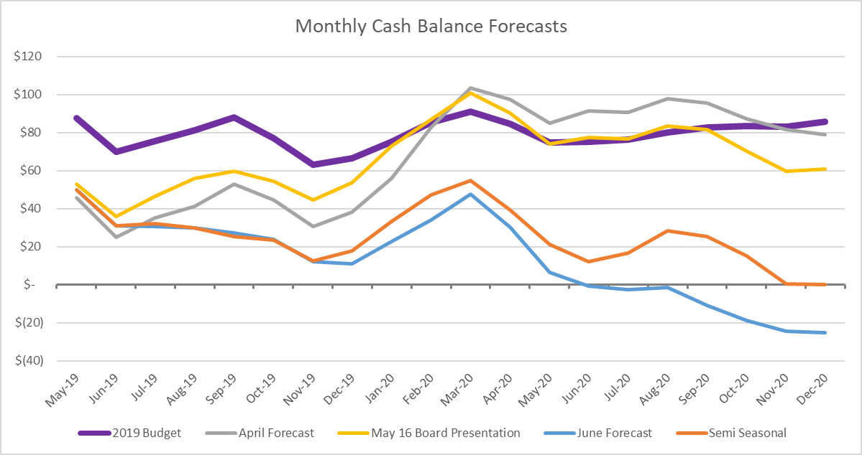
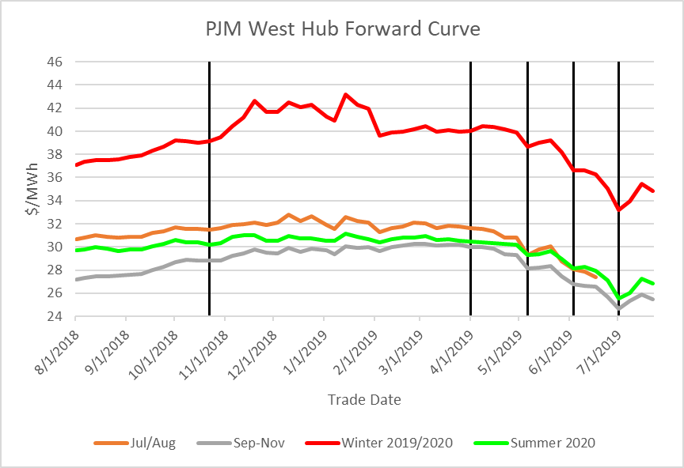
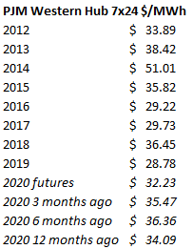
Current Status Overview
PJM market pricing has been steadily declining since Q1 2019 impacting Homer City’s P&L. Utilizing both current forwards and operating costs presented at the May 2019 Board meeting, Homer City encounters a potential 2019 liquidity period requiring cost reduction efforts to allow the facility to reach it’s usual opportunity for profitable winter months.
The PJM forward curve has been on a steady decline since the end of Q1 2019. The 2019/2020 winter strip has taken the biggest hit, declining from $40/MWh ATC to just under $34/MWh ATC in July.
The erosion in forward pricing has created liquidity concerns for Homer City despite the project achieving favorable availability. Low PJM capacity pricing further worsens the problem through May 2021.
Actions recommended in this presentation can be expected to generate $32MM in fixed expense savings providing Homer City with positive liquidity through 2020 barring further erosion of market prices. These actions introduce additional operational risks which will be discussed.
DSCR covenants are met due to major maintenance reserve and term loan proceeds mechanics until liquidity is exhausted.
Apr Forecast
May Forecast
Budget
Jun Forecast
Jul Forecast

Slide 15
2019 / 20 Recommendations and Risks
Recommendations:
2019: BOY fixed expense savings $6MM, Reduced coal inventory $3.83MM
Revising BOY coal purchases and dispatch to balance Q4 2019 liquidity with on-site inventory for Q1 2020 market opportunity
November Murray purchases reduced by 75k tons
70% of 2019 Balance of year fixed expenses is comprised of Payroll, Routine Maintenance and Contractors/Consultants
2019 $6MM contractor/consultants reduction produces savings with little impact on winter operational readiness
2020: Fixed expense savings $26MM
Staffing cut of 25% and contractor reduction post 19/20 winter estimated to be $23MM
Additional $3MM reduction in Major Maintenance
Reduce 2020 annual coal burn to 2.75 million tons by electing 500k deferral with desire to reduce Murray minimum further to provide flexibility in case of further market or availability downside
Risks
Most significant risk is availability and readiness for the upcoming winter operations. Capturing cost reductions that have limited impact to winter operations provides additional cushion to cash low point
Availability factor may drop significantly due to reductions in maintenance
Murray does not agree to reduction in 2020 minimum or requires a term extension and/or pricing increase
July – Dec ’19 Expenses Prior to Recommendations

Slide 16
2019 Forecast vs 2019 Budget & 2020 Forecast
Key Assumptions:
Actuals through June
Power & coal prices based on mid-market forwards as of 7/26/2019 for July through Dec 2020
12% unplanned outage factor Jul 2019 – Dec 2020
2019 Forecast vs Budget
Gross Margin is $39MM unfavorable to budget driven by unfavorable energy prices across all of PJM
$20.4MM unfavorable though June
$14.7MM unfavorable Q3 & $4.0MM unfavorable Q4
Favorable availability is driven by YTD 8% favorable availability
Fixed expenses $7.2MM favorable to budget
$1.2MM favorable YTD (June 2019)
Fixed cost July-Dec forecasted to be an additional $6.0MM below budget. Continual effort to further reduce
Changes in W/C $11.7MM unfavorable mainly due to Coal inventory build-up for winter
Starting Cash Balance $7.1MM unfavorable to budget due to unfavorable Q4 2018 actuals. $3.7MM related to the return of the Two Lick Dam LC cash collateral which was received in May 2019
See Appendix for detailed 2019 Forecast vs Budget
2020 Forecast vs 2019 Actuals/Forecast
Gross Margin for 2020 forecasted to be $19.5MM below 2019
Improved NEM due to slightly higher spreads offset by considerably lower capacity payment and hedge P&L vs 2019
Fixed Costs for 2020 forecasted to be $35.4MM below 2019
No major outages ($22.5MM vs $46.8MM in 2019)
Incorporates recommendations from previous slide

Slide 17
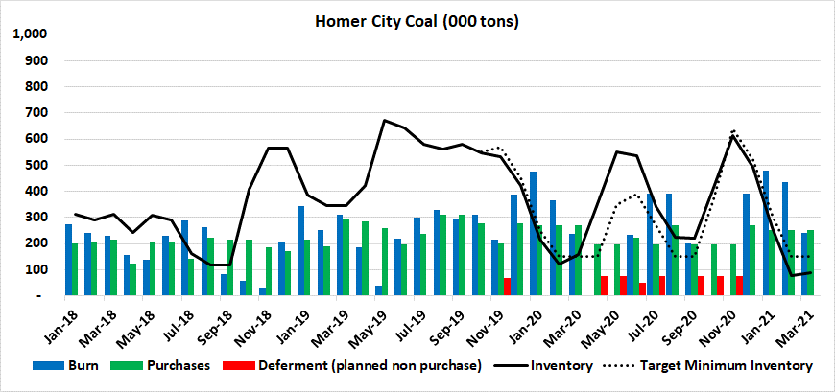
Coal Inventory Forecast
Homer City has purchased 1.5MM tons through July, with a forecast of 1.4MM tons for balance of the year. Homer City can further reduce 2019 coal purchases by 150k tons.
36k tons per month for August & September with two weeks notice
75k tons for December with notice by Sept 1
Inventory prior to winter months is 100k tons below target inventory levels and is at risk of having adequate supply to capture the full market opportunity by rationing coal if winter pricing is strong.
0.3 million tons of YTD train shipment shortfall not made up in balance of year resulting in $1.5 million of favorable coal price foregone.
High recent inventory
Below target winter inventory
Below target winter inventory

Slide 18
Winter Hedging Discussion
Confidential

Slide 19
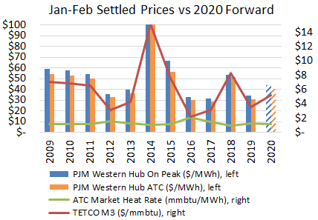
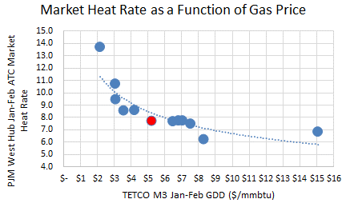
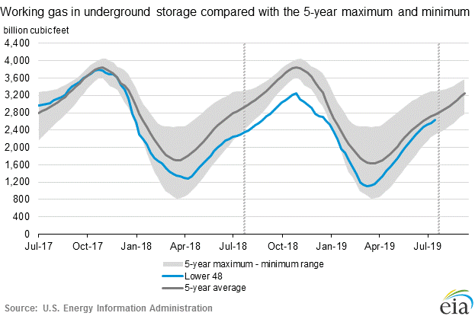
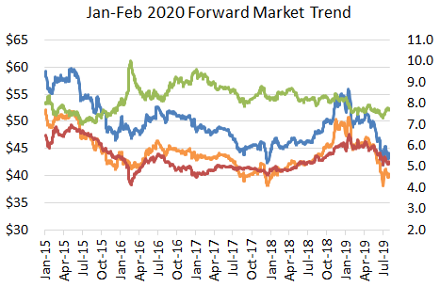
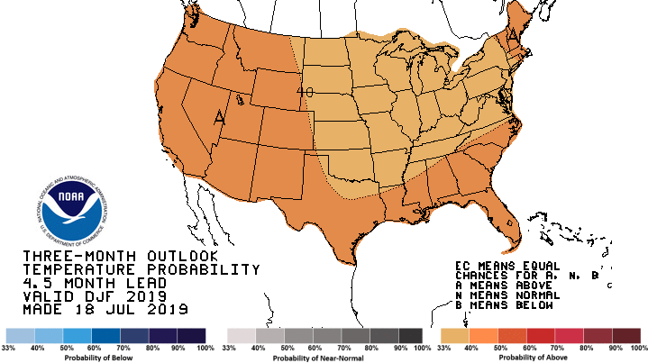
Winter 2019/20 Power Price Fundamentals
2020 in line with 5 year historical
2016
Market heat rate in line with historical values for given gas price
2012
2017
2011, 2010, 2009, 2015
2019, 2013
2014
2020 fwd
2018
Warmer than normal winter forecasted
Gas traded lower; market heat rates at 3 year low
Gas in storage is near 5 year average and increasing

Slide 20
Trade Request for Approval: Winter 2019/20
Forward prices have trended lower with weakening gas prices, but still have significant margin for Homer City.
Homer City’s winter energy margin is partially hedged via the Murray price structure, but does not have any power hedges in place at this time. CPV recommends hedging price targets for December 2019 – March 2020 at PJM Western Hub to hedge energy margin to reduce cash flow at risk while managing cover costs from operational risks:
Sell forward call option on power to generate upfront cash.
Up to 200 MW Jan-Feb with strike price of at least $42.50/MWh or higher for premium of at least $[10]/MWh resulting in $3 million cash premium payment to Homer City
Sell forward fixed price power to hedge partially energy margin.
Sell 200 MW Dec-Mar at current prices
Sell additional 200 MW Dec-Mar at prices that are $4/MWh ATC higher than current prices
Target buying put option to protect downside energy margin. Unlikely to be executed now, but may be executable with forward market volatility. (put premium paid as settled, not up front)
Buy 400 MW put option with spike price of at least $38/MWh ATC for a premium of no more than $[5]/MWh
All transactions will be executed consistent with the risk management policy. Under the risk management policy, CPV may utilize its hedging authority to execute additional prompt month hedges.
Hedge targets are for PJM Western Hub.
Dec-Mar Energy Margin ($ million) | Forecast (7/25/2019) | Downside Risk | Upside Potential
Current Position | $39 MM | -$39 MM | +$24 MM
Hedged Position (Call & Power Sold / Put Bought) |  | -$30 MM / -$21 MM | +$15 MM
Hedged Position with downside availability (60%) | $28 MM | -$19 MM / -$10 MM | +$7 MM
Downside energy margin at risk is the change in energy margin if prices settle at the 2017 settled values (2017 settled used as the downside as it is the lowest settled price since 2002 and is lower than mid-market forwards minus 2 standard deviations of forward mid-market price volatility).
Upside energy margin potential is the change in energy margin if prices settle $5/MWh higher than forward mid-market

Slide 21
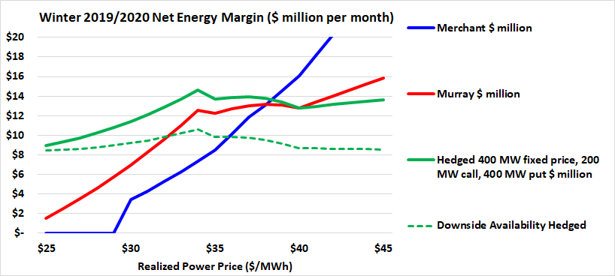
Murray Energy Contract Profit Sharing
Murray contract provides a 100% hedge for power prices $35-40/MWh and 50% hedge at prices >$40/MWh
As dark spread sharing starts at 20% for $35/MWh power price to 50% sharing at $40/MWh, Murray is paid an additional $2.73/ton for every $1/MWh of power price increase, representing a 100% hedge. (it is overhedged for the increment from $34.99 to 35.01/MWh when sharing starts)
As dark spread sharing increases above $40/MWh, Murray is paid an additional $1.27/ton for every $1/MWh of power price increase, representing a 50% hedge
To further hedge Homer City’s energy margin, Homer City could sell fixed price power and buy a collar with a put option and call option
The Murray contract has significantly less unit performance risk than forward power sales. Forward power sales and the call option are firm LD, but Murray purchases are based on unit fuel burn which can be taken in any month.
Revenue varies with power price and coal is fixed price; energy margin is 1:1 with power price
Significant upside and downside potential
Profit sharing function as 100% hedge between $35-40/MWh and a 50% hedge above $40/MWh
Margin below $35/MWh is higher than merchant for discounted coal
Margin above $40/MWh is lower than merchant for coal profit sharing
Provides limited upside and downside potential
Decreasing availability from 88% to 60% eliminates any upside potential, but limits over hedging if market prices are high

Slide 22
Past Hedging Actions & Results
Summer 2017:
800 MW settled +$5 million gain
Winter 2017-2018:
1200 MW settled -$14 million loss
Summer 2018:
300 MW settled -$1 million loss
Winter 2018-2019:
300 MW + 300 MW put / 150 MW call settled +$22 million gain
Summer 2019:
No hedges; forward prices did not reach targets; June & July prices settled below forwards.
Winter 2019-2020:
Up to 600 MW sold (800 MW with put option)

Slide 23
Upcoming Activities
Confidential

Slide 24
Upcoming Activities
Coal Contract Negotiations
Reduce annual contract minimum from 2.75 million tons to 1.8 million tons and reduce contract base (expected) quantity from 3.25 million tons to 2.75 million tons. Keep price and term increase minimal.
Negotiate 2021 & beyond contract when power pricing expectations are more favorable.
CBA Renewal
Insurance Renewal
2020 Budget Schedule
place holder slide
Schedules / bullets on activity

Slide 25
Next Meeting
Confidential

Slide 26
Next Meeting
Proposed Date: Wednesday November 13th, 2019
Location: Homer City Generation Station
Future Dates
Wednesday February 12th, 2019 or February 19th, 2019
Bill – which date do you want to propose

Slide 27
Appendix

Slide 28
2019 Forecast vs 2019 Budget

